Slide 1
Xamarin.iOS
Binding native libraries

Slide 2
Xamarin.iOS: Binding native libraries
Robert Hedgpeth
Mobile Architect, Xamarin
Senior Software Engineer, Microsoft
@robhedgpeth
https://github.com/rhedgpeth/
rob@hedgpethconsulting.com
http://www.hedgpethconsulting.com
Notes:
This is a Client Services’ Coding Best Practices presentation on
General memory management best practices
Using profiling to pinpoint and eliminate performance issues with apps
A look at performance best practices and common pitfalls for Xamarin.iOS, Xamarin.Android, and Xamarin.Forms

Slide 3





































TITANIUM SPONSORS
Platinum Sponsors
Gold Sponsors

Slide 4
What is Xamarin?
Xamarin is a cross-platform implementations of the Common Language (CLS). CLS is a fundamental set of language features supported by the Common Language Runtime (CLR) of the .NET Framework.
With a C#-shared code base, developers can use Xamarin tools to write native Android, iOS, and Windows apps with native user interfaces and share code across multiple platforms.

Slide 5
What is Xamarin?
Notes:
This is a Client Services’ Coding Best Practices presentation on
General memory management best practices
Using profiling to pinpoint and eliminate performance issues with apps
A look at performance best practices and common pitfalls for Xamarin.iOS, Xamarin.Android, and Xamarin.Forms

Slide 6
What is Xamarin.iOS?
C# is ahead-of-time (AOT) compiled to ARM assembly language. The .NET framework is included, with unused classes being stripped out during linking to reduce the application size.
Notes:
Notes on the AOT process here
For iOS apps, we first compile each of the DLLs into Intermediary Language (IL). Then, for each library we generate a mach-o file, which is fed into the compiler. We project out all the possible code paths from things like generics, and then link away unnecessary binary code to optimize app package size. The final result is an ARM binary package (the same output you would get from an Obj-C package).

Slide 7
Why use Xamarin.iOS?
Written in a common language; C#
Potentially large amount of code sharing through the use of .NET features such as shared projects and Portable Class Libraries (PCL’s)
Nuget packages
Components store
Testing Integration
Develop with Visual Studio or Xamarin Studio IDEs
Notes:
This is a Client Services’ Coding Best Practices presentation on
General memory management best practices
Using profiling to pinpoint and eliminate performance issues with apps
A look at performance best practices and common pitfalls for Xamarin.iOS, Xamarin.Android, and Xamarin.Forms

Slide 8
Packages and Components
Xamarin Components provide a variety of different components to use in Xamarin.iOS and Xamarin.Android applications. Components range from user interface controls to code libraries, as well as user interface themes. They allow applications built on Xamarin to create rich user experiences and integrate with many different third party services with very little work.
Nuget Packages

Slide 9
How does that compare to native options?
400+ Components
Hundreds of iOS accessible packages
4650+ Cocoa Controls
18K+ CocoaPods
Notes:
CocoaControls: Custom controls and views for iOS and MacOS
CocoaPods: package/dependency manager for Swift and Objective-C

Slide 10
How does that compare to native options?
Notes:
This is a Client Services’ Coding Best Practices presentation on
General memory management best practices
Using profiling to pinpoint and eliminate performance issues with apps
A look at performance best practices and common pitfalls for Xamarin.iOS, Xamarin.Android, and Xamarin.Forms

Slide 11
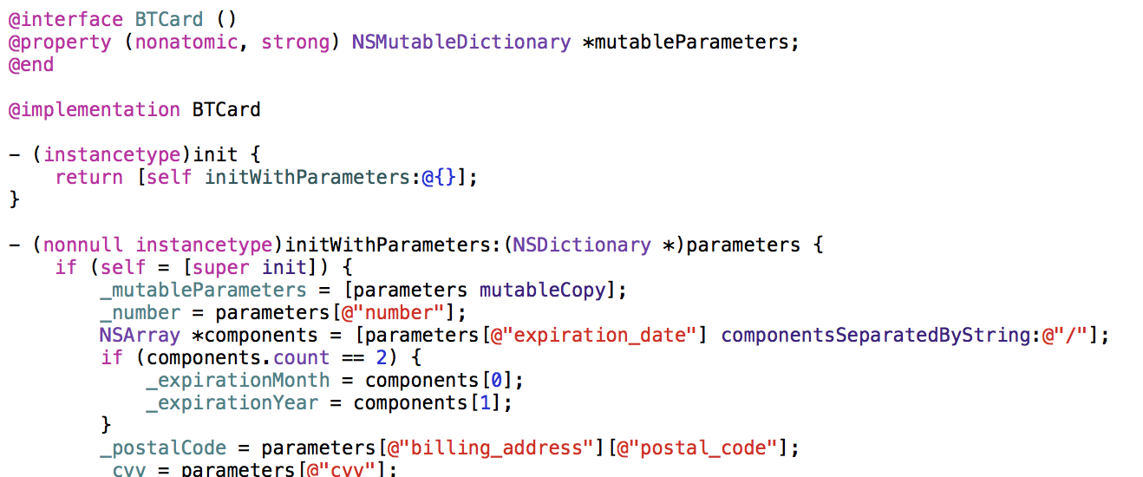
So what can be done?
Option #1: Porting the Objective-C code to C#
Notes:
This is a Client Services’ Coding Best Practices presentation on
General memory management best practices
Using profiling to pinpoint and eliminate performance issues with apps
A look at performance best practices and common pitfalls for Xamarin.iOS, Xamarin.Android, and Xamarin.Forms

Slide 12
Option #1: Porting the Objective-C code

Slide 13
Option #2: Xamarin.iOS Binding
Xamarin Binding Projects can be used to create a C# binding (translation) to native Objective-C libraries.
What can binding projects be used for?
Xamarin.Mac
Xamarin.iOS
What kind of libraries can be bound?
XCode projects
Frameworks*
Pods
Notes:
This is a Client Services’ Coding Best Practices presentation on
General memory management best practices
Using profiling to pinpoint and eliminate performance issues with apps
A look at performance best practices and common pitfalls for Xamarin.iOS, Xamarin.Android, and Xamarin.Forms

Slide 14
Under the hood
Static and Fat libraries
C# invokes Objective-C selectors.
Selectors are messages that can be sent to an object or class (that exist in Objective-C).
Ex.) Xamarin.iOS maps instance selectors to instance methods, and class selectors to static methods.
[Register] is used to register a class to the Objective-C runtime.
[Export] is used to export a method or property.
Notes:
A static library is a package of classes, functions, definitions and resources, which you can pack together and easily share between your projects.

Slide 15
Xamarin.iOS Binding Project
Notes:
This is a Client Services’ Coding Best Practices presentation on
General memory management best practices
Using profiling to pinpoint and eliminate performance issues with apps
A look at performance best practices and common pitfalls for Xamarin.iOS, Xamarin.Android, and Xamarin.Forms

Slide 16
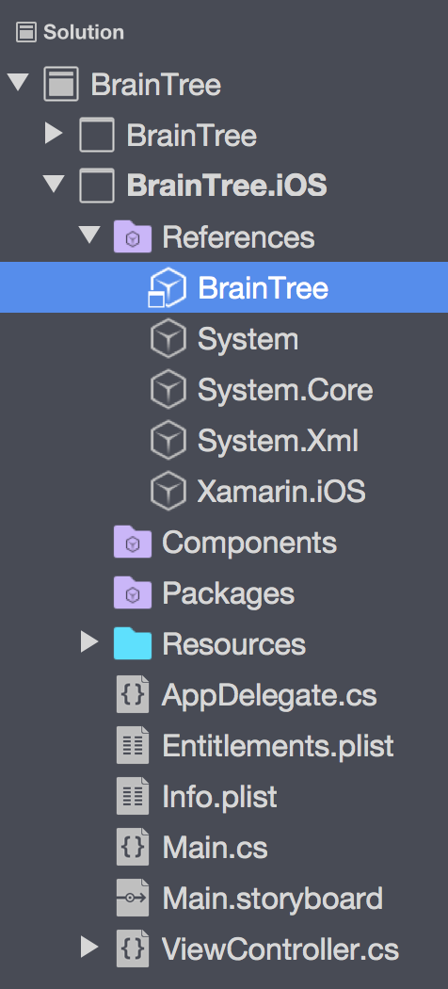
Xamarin.iOS Binding Project
Reference can be added by multiple project types
The C# bindings can be accessed (with full Intellisense) just like they would be in Objective-C (kind of)
Notes:
This is a Client Services’ Coding Best Practices presentation on
General memory management best practices
Using profiling to pinpoint and eliminate performance issues with apps
A look at performance best practices and common pitfalls for Xamarin.iOS, Xamarin.Android, and Xamarin.Forms

Slide 17
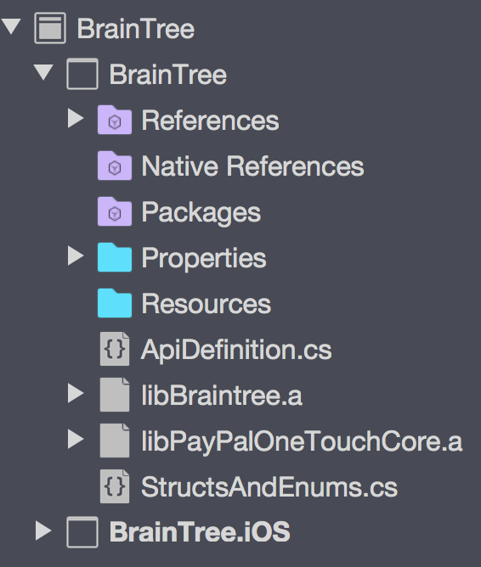
Xamarin.iOS Binding Projects
ApiDefinition.cs
StructsAndEnums.cs
Extras.cs
libNative.a
libNative.linkwith.cs
Notes:
This is a Client Services’ Coding Best Practices presentation on
General memory management best practices
Using profiling to pinpoint and eliminate performance issues with apps
A look at performance best practices and common pitfalls for Xamarin.iOS, Xamarin.Android, and Xamarin.Forms

Slide 18
Xamarin.iOS Binding Projects
Notes:
This is a Client Services’ Coding Best Practices presentation on
General memory management best practices
Using profiling to pinpoint and eliminate performance issues with apps
A look at performance best practices and common pitfalls for Xamarin.iOS, Xamarin.Android, and Xamarin.Forms

Slide 19
libNative.a
Static library
Fat library
Multiple architecture support
Makefile
Simply add to the binding project
Notes:
This is a Client Services’ Coding Best Practices presentation on
General memory management best practices
Using profiling to pinpoint and eliminate performance issues with apps
A look at performance best practices and common pitfalls for Xamarin.iOS, Xamarin.Android, and Xamarin.Forms

Slide 20
libNative.linkwith.cs
This linkwith.cs file is a way to tell the IDE to package the static library into the resulting DLL.
Specifies which architectures the DLL should support (ArmV7, Simulator64, Arm64, etc.), and links against other frameworks (i.e. UIKit, Foundation), if needed.
It is composed of several “using” statements as well as an assembly level attribute named, of all things, LinkWith.
Notes:
This is a Client Services’ Coding Best Practices presentation on
General memory management best practices
Using profiling to pinpoint and eliminate performance issues with apps
A look at performance best practices and common pitfalls for Xamarin.iOS, Xamarin.Android, and Xamarin.Forms

Slide 21
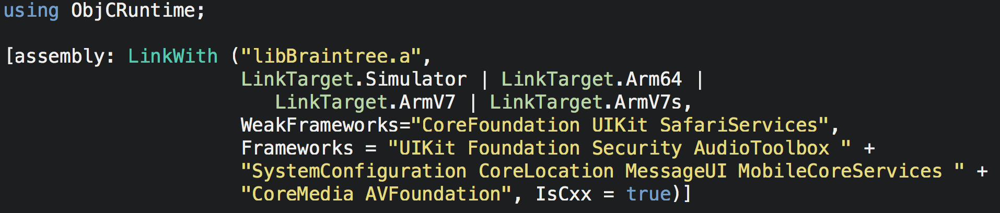
libNative.linkwith.cs
Notes:
This is a Client Services’ Coding Best Practices presentation on
General memory management best practices
Using profiling to pinpoint and eliminate performance issues with apps
A look at performance best practices and common pitfalls for Xamarin.iOS, Xamarin.Android, and Xamarin.Forms

Slide 22
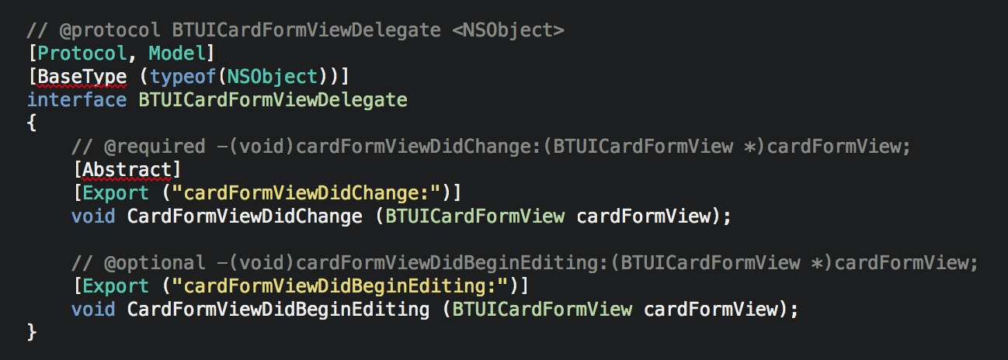
ApiDefinition.cs
The APIDefinition.cs is used to define the mapping between the Objective-C library we are binding and the C# code that we will eventually consume in our iOS application.
Limited to interface and delegate declarations.
Notes:
How the mappings work, technically.
Why interfaces?

Slide 23
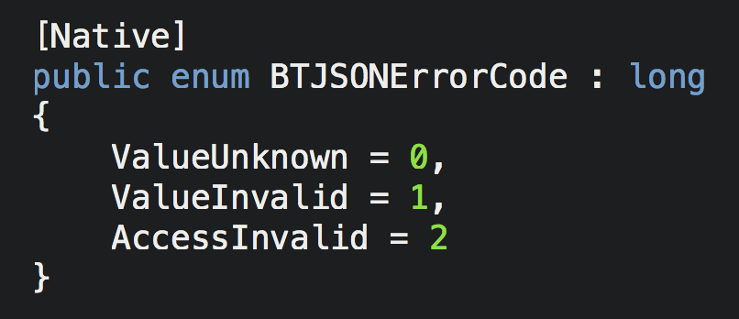
StructsAndEnums.cs
The StructsAndEnums.cs file is the file where you will enter any definitions that are required by the interfaces and delegates. This includes enumeration values and structures that your code might use.
Notes:
This is a Client Services’ Coding Best Practices presentation on
General memory management best practices
Using profiling to pinpoint and eliminate performance issues with apps
A look at performance best practices and common pitfalls for Xamarin.iOS, Xamarin.Android, and Xamarin.Forms

Slide 24
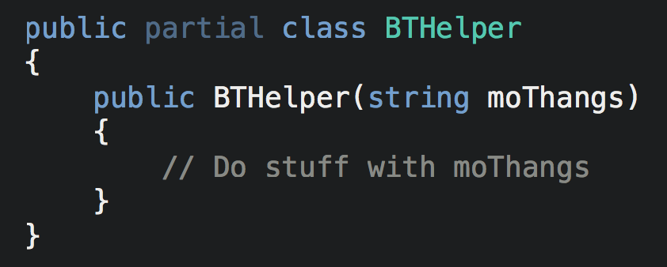
Extra.cs
Extras.cs (or whatever you name it) file is used to define C# partial classes based off the interfaces we created in the APIDefinitions.cs file.
Can be used to create anything (methods, constructors, properties, etc.) that a class might use to make dealing with the underlying bound library easier.
Notes:
This is a Client Services’ Coding Best Practices presentation on
General memory management best practices
Using profiling to pinpoint and eliminate performance issues with apps
A look at performance best practices and common pitfalls for Xamarin.iOS, Xamarin.Android, and Xamarin.Forms

Slide 25
Where’s the beef?
The main action mostly happens in ApiDefinitions.cs
Where does the data come from?
Must consider several components
Classes
Protocols
Constructors
Properties
Methods
Blocks
Notes:
TODO:
- Header → Magic Box (binding process) → C# consumptions

Slide 26
Binding Classes
Classes are defined with the keyword “@interface”.
Class which they inherit from is followed by a colon then the parent’s class name.
The [BaseType] attribute (which uses [Register]) will decorate the interface which maps the Objective-C class to C#. This attribute takes a typeof operator in its constructor.
Notes:
Why interfaces (again)?
C# is a single inheritance method

Slide 27
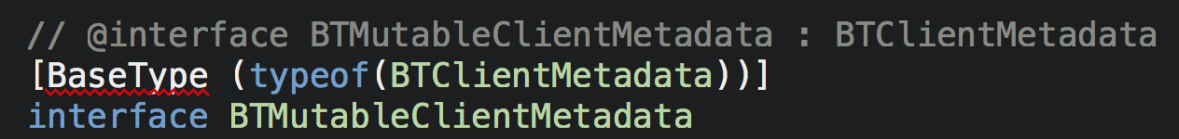
Binding Classes
Should not contain classes, enumerations, delegates or structs. The API definition file is merely the contract that will be used to generate the API.
Here we will specify the type of iOS class the class we are mapping derives from. In this case, the BTClientMetadata.
Notes:
Why interfaces (again)?
C# is a single inheritance method

Slide 28
Binding Protocols
Protocols in Objective-C are very similar to the concept of events in C#, but instead of an event being raised, a method is called in another class.
Have both mandatory and optional methods.
A mandatory method must be defined in the implementing class, while an optional method is… optional!
A protocol is bound very much like a class. The only difference is that the interface is also decorated with the [Model] and [Protocol] attributes.
Notes:
MORE INFO ON THIS!

Slide 29
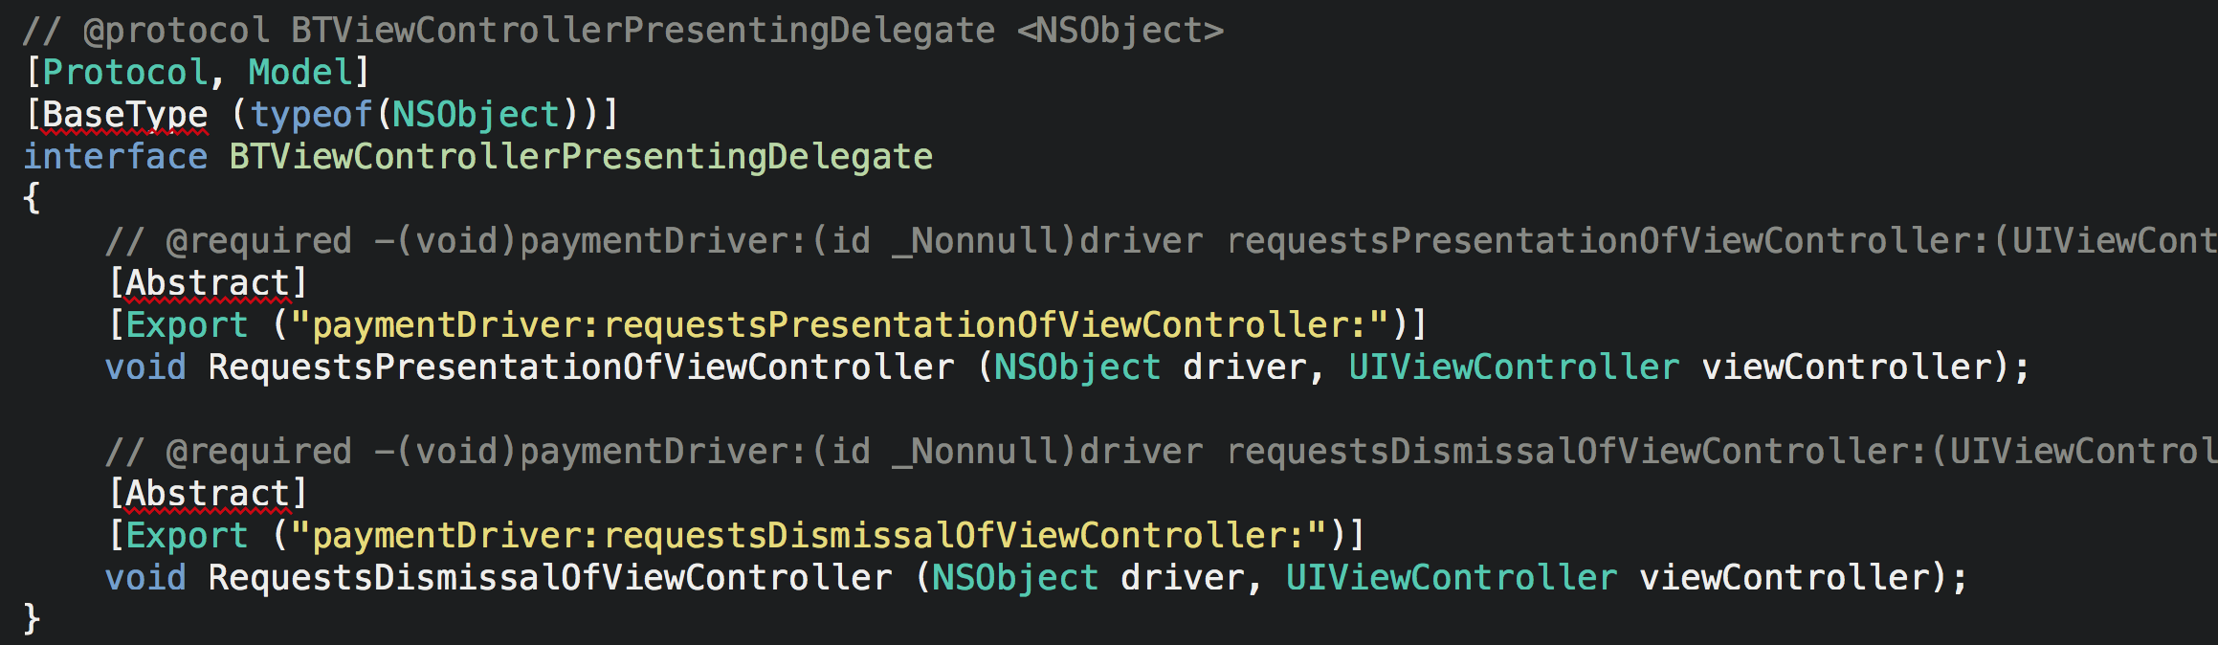
Binding Protocols
Notes:
This is a Client Services’ Coding Best Practices presentation on
General memory management best practices
Using profiling to pinpoint and eliminate performance issues with apps
A look at performance best practices and common pitfalls for Xamarin.iOS, Xamarin.Android, and Xamarin.Forms

Slide 30
Binding Constructors
Constructors within Objective-C start with a “-”.
Generally return an “instancetype” or “id”.
Convention has it that the constructor’s name begin with “init”.
To bind to any other Objective-C constructor the following rules must be followed:
The [Export] attribute with the custom constructor’s name is still used.
The method must return an IntPtr (pointer) object.
The method name must be Constructor.
Notes:
DOUBLE CHECK THE LAST POINT

Slide 31
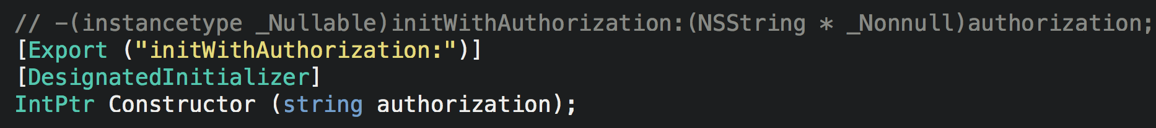
Binding Constructors
Notes:
This is a Client Services’ Coding Best Practices presentation on
General memory management best practices
Using profiling to pinpoint and eliminate performance issues with apps
A look at performance best practices and common pitfalls for Xamarin.iOS, Xamarin.Android, and Xamarin.Forms

Slide 32
Binding Methods
Method definitions are found within the class definition itself.
Start with a “-” or “+” character.
The – indicates an instance method
The + indicates a static method.
The return type of the method is indicated next, surrounded by parentheses.
In Objective-C the entire method name is separated by colons, followed by an input parameter’s type surrounded by parentheses, and then the parameter’s name.
Notes:
This is a Client Services’ Coding Best Practices presentation on
General memory management best practices
Using profiling to pinpoint and eliminate performance issues with apps
A look at performance best practices and common pitfalls for Xamarin.iOS, Xamarin.Android, and Xamarin.Forms

Slide 33
Binding Methods
Binding methods is relatively straight forward:
All methods are decorated with an [Export] attribute.
The return value of the C# declaration will be the same as the Objective-C one.
Data type conversions can be found in the Xamarin documentation. (i.e. NSInteger = nint, int, long, float = NSNumber, etc.)
Notes:
This is a Client Services’ Coding Best Practices presentation on
General memory management best practices
Using profiling to pinpoint and eliminate performance issues with apps
A look at performance best practices and common pitfalls for Xamarin.iOS, Xamarin.Android, and Xamarin.Forms

Slide 34
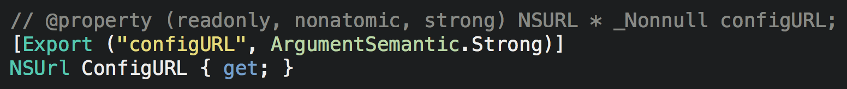
Binding Properties
Properties start with “@property”.
For binding use the [Export] attribute.
Can use the [Internal] and [Static] attributes just as in methods.
The [NullAllowed] attribute can be specified on the property itself or on the setter.
Notes:
This is a Client Services’ Coding Best Practices presentation on
General memory management best practices
Using profiling to pinpoint and eliminate performance issues with apps
A look at performance best practices and common pitfalls for Xamarin.iOS, Xamarin.Android, and Xamarin.Forms

Slide 35
Binding Blocks
Blocks are a lot like anonymous methods in C#, and can be thought of as a delegate.
When you see the “^” symbol.
One or more input parameter types (and sometimes names) following.
Notes:
This is a Client Services’ Coding Best Practices presentation on
General memory management best practices
Using profiling to pinpoint and eliminate performance issues with apps
A look at performance best practices and common pitfalls for Xamarin.iOS, Xamarin.Android, and Xamarin.Forms

Slide 36
Wow, that was a lot of sh..stuff!
Objective Sharpie
A command line tool to help bootstrap the first pass of a binding.
Parses the header files of a native library to map the public API into the binding definition.
What can be bound using Objective Sharpie?
(XCode) Projects
Pods
Individual files
Notes:
This is a Client Services’ Coding Best Practices presentation on
General memory management best practices
Using profiling to pinpoint and eliminate performance issues with apps
A look at performance best practices and common pitfalls for Xamarin.iOS, Xamarin.Android, and Xamarin.Forms

Slide 37
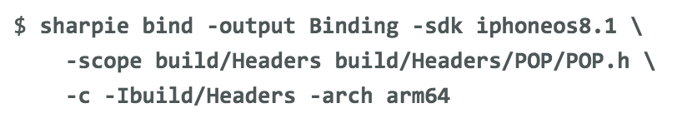
Objective Sharpie
Projects
Individual files
Notes:
This is a Client Services’ Coding Best Practices presentation on
General memory management best practices
Using profiling to pinpoint and eliminate performance issues with apps
A look at performance best practices and common pitfalls for Xamarin.iOS, Xamarin.Android, and Xamarin.Forms

Slide 38
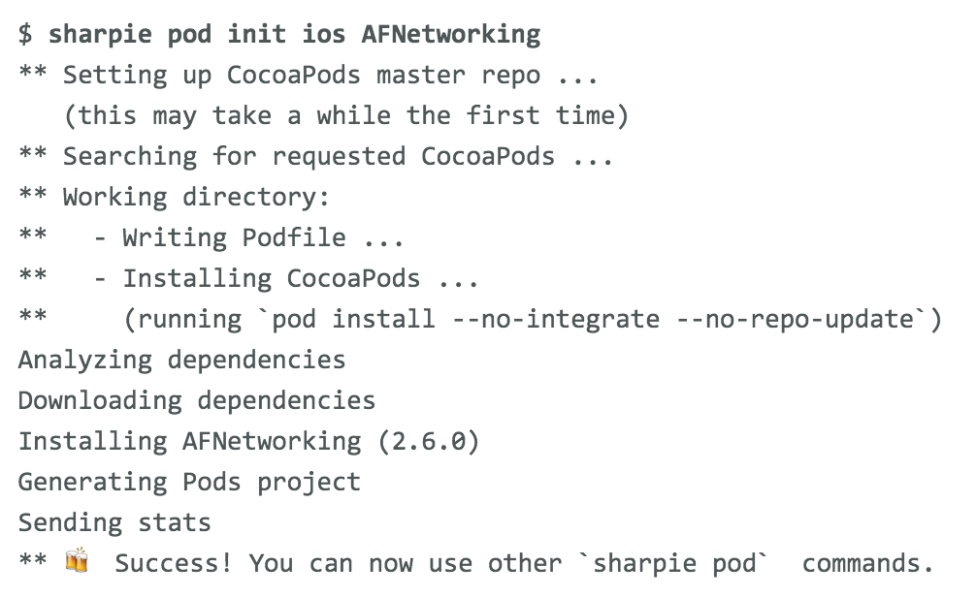
Objective Sharpie
Pods
Notes:
This is a Client Services’ Coding Best Practices presentation on
General memory management best practices
Using profiling to pinpoint and eliminate performance issues with apps
A look at performance best practices and common pitfalls for Xamarin.iOS, Xamarin.Android, and Xamarin.Forms

Slide 39
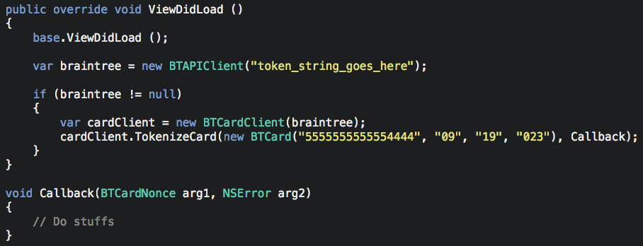
Using the bindings
Notes:
This is a Client Services’ Coding Best Practices presentation on
General memory management best practices
Using profiling to pinpoint and eliminate performance issues with apps
A look at performance best practices and common pitfalls for Xamarin.iOS, Xamarin.Android, and Xamarin.Forms

Slide 40
The code
https://github.com/rhedgpeth/BrainTree-Xamarin.iOS-Binding

Slide 41
Resources
Xamarin documentation
Various (Github) examples
Me!
rob@hedgpethconsulting.com
@robhedgpeth
Notes:
This is a Client Services’ Coding Best Practices presentation on
General memory management best practices
Using profiling to pinpoint and eliminate performance issues with apps
A look at performance best practices and common pitfalls for Xamarin.iOS, Xamarin.Android, and Xamarin.Forms

